Slide 1
Lessons Learned & Future Challenges
Promoting and advancing the development
of healthy, durable, and sustainable shelter for Alaskans and other Circumpolar people.
Bruno Grunau, PE • 21 November 2018 • bruno@cchrc.org

Slide 2
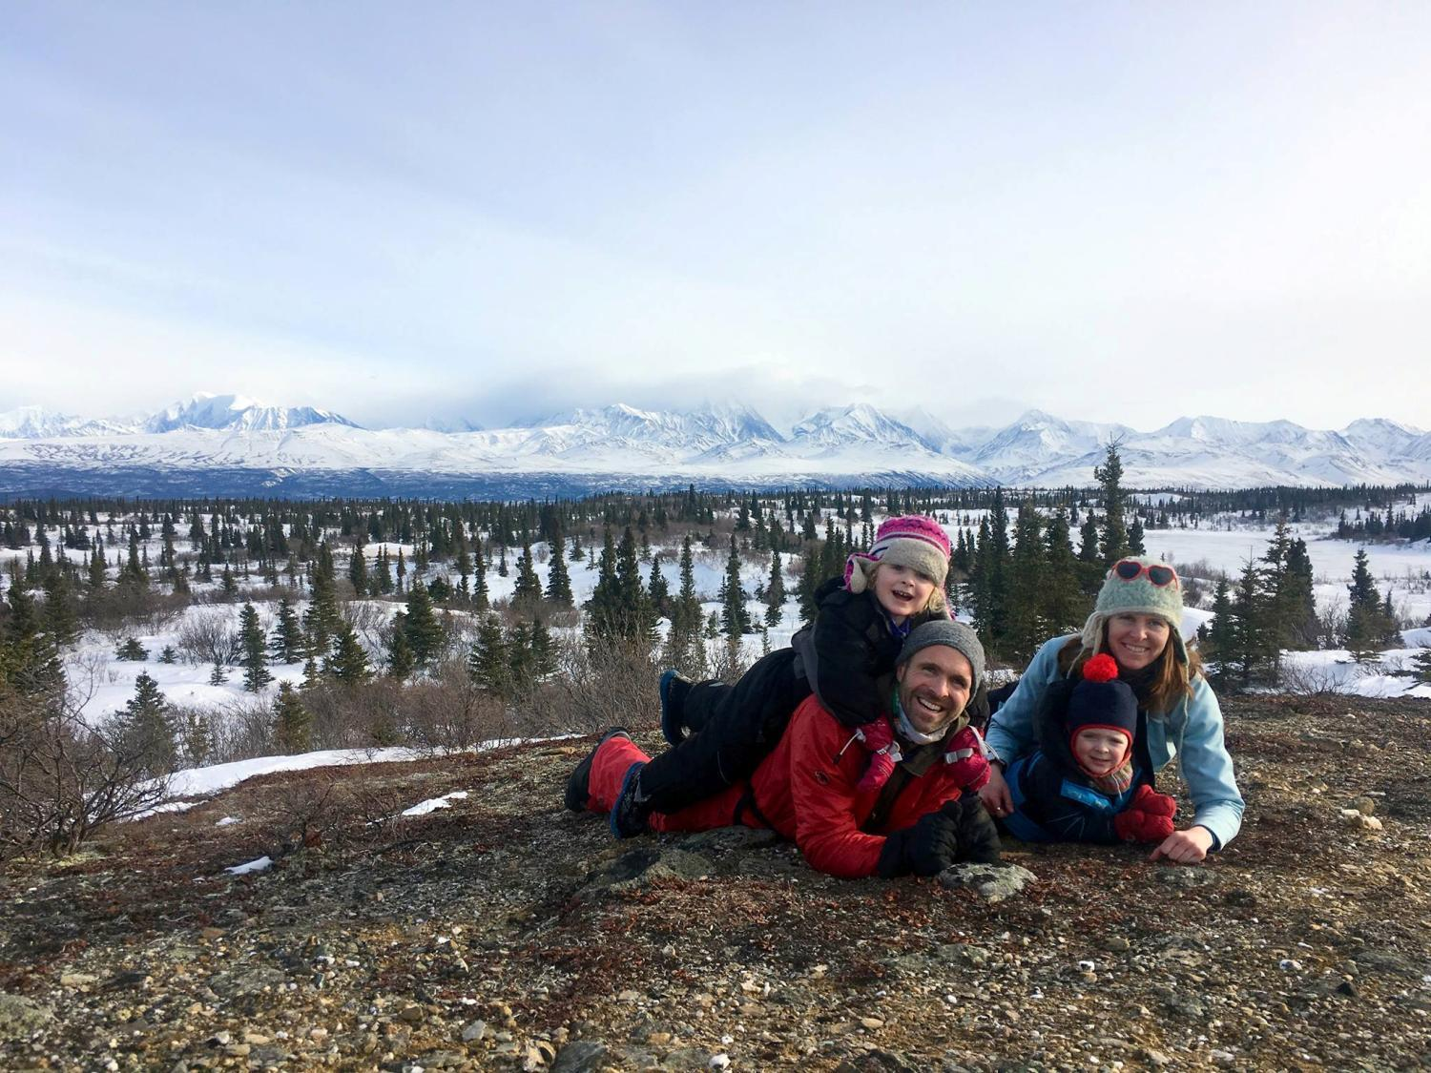

Slide 3
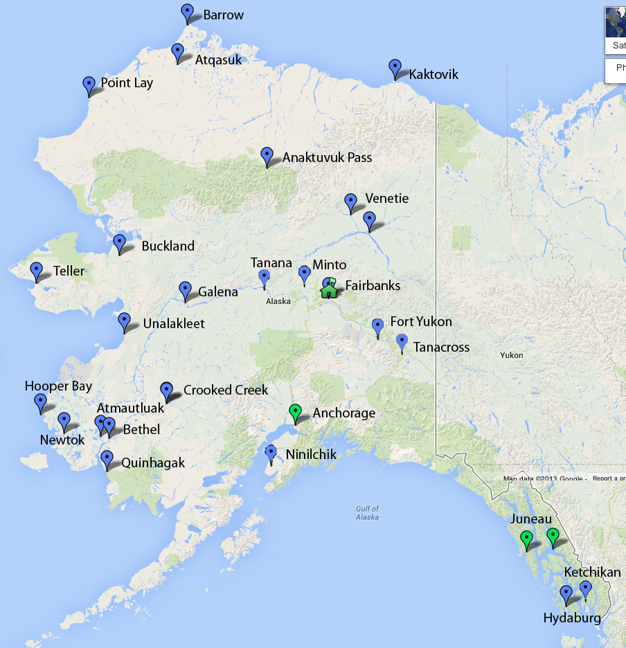

Cold Climate Housing Research Center
CCHRC
Sustainable Northern Communities
Building Alaska’s
Future Together
www.cchrc.org

Slide 4
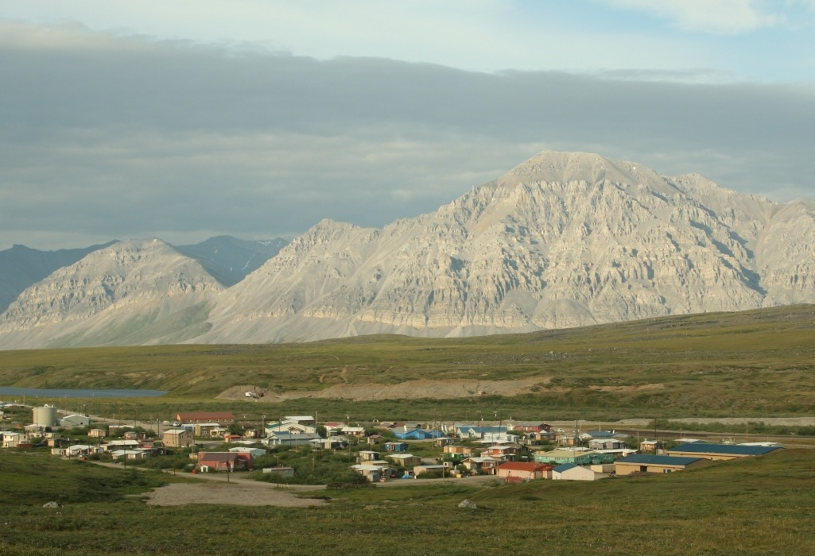
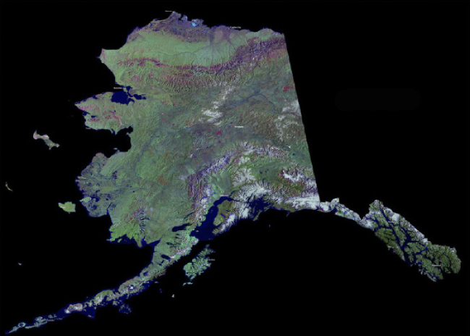
Point Lay
Anaktuvuk Pass
ANAKTUVUK PASS
Fairbanks
Newtok
Juneau
Quinhagak
Anchorage
www.cchrc.org
Notes:
Spaceships – 13,000 years – Indigenous Wisdom/21st Century Technology – Design Charettes

Slide 5
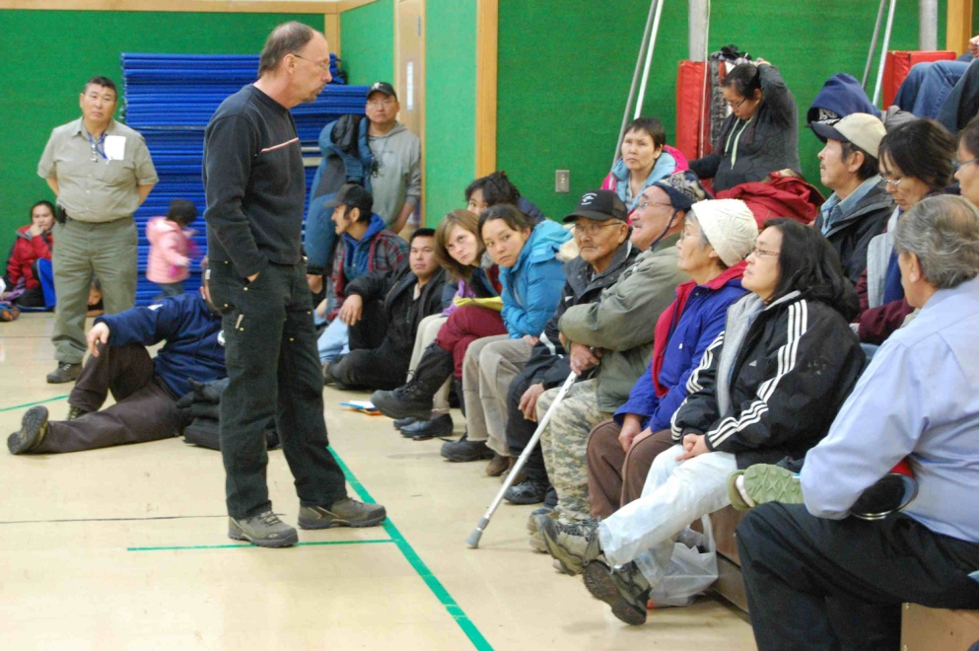

Slide 6
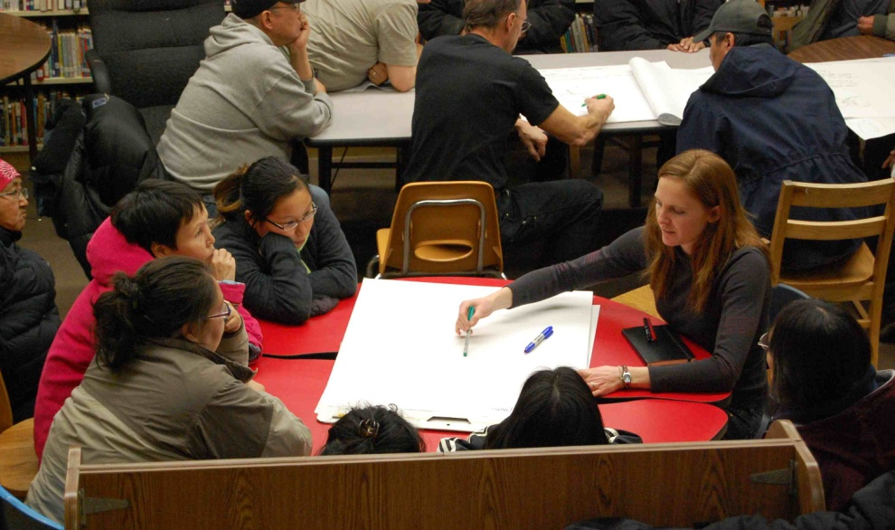

Slide 7
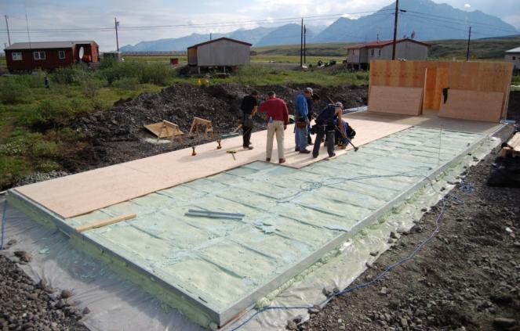
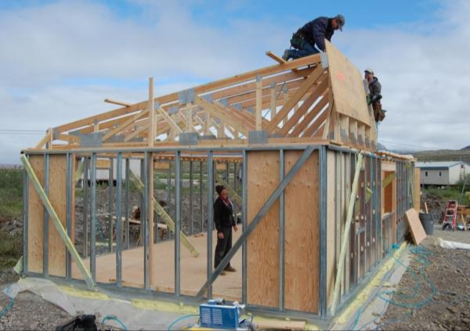
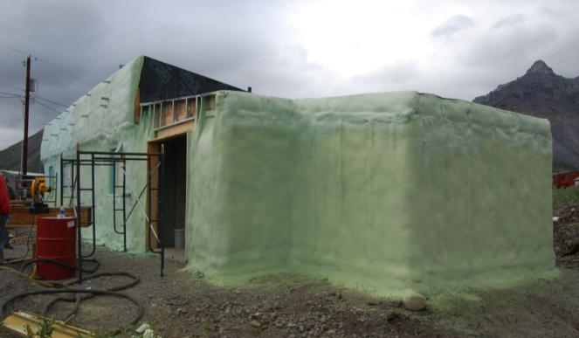
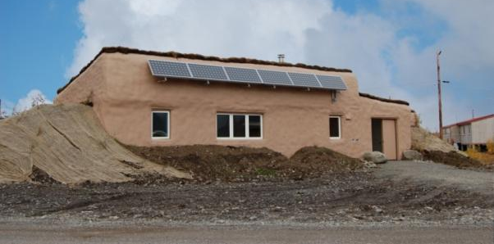
Cold Climate Housing Research Center
CCHRC
Anaktuvuk Pass Prototype Home
www.cchrc.org

Slide 8
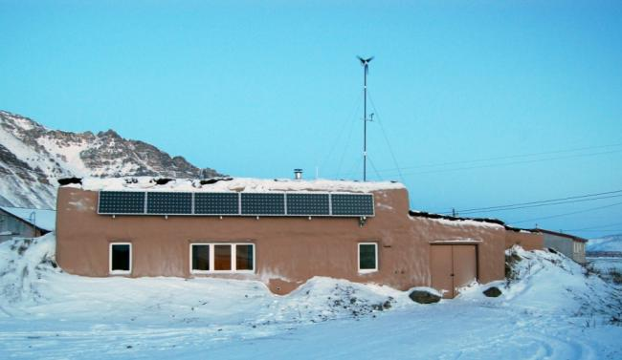
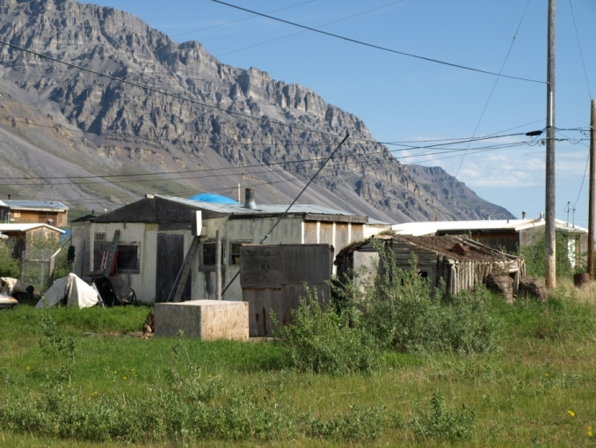
Cold Climate Housing Research Center
CCHRC
Sustainable Northern Communities
“We need housing. Our young people have no place to live.”
George Paneak (1950-2009) Former Mayor of Anaktuvuk Pass
Design Challenges
17,000 HDD
Heating Oil $8/gallon
1,200 - 1,400 gallons/yr.
New house is $500,000 - $750,000
Last house built ten years ago
Context appropriate housing
Transportation costs
Construction Outcomes
Cost significantly less than new home quotes
190-200 gallons fuel annually
Completed in four weeks
Local work force
Major step toward Net 0
www.cchrc.org

Slide 9
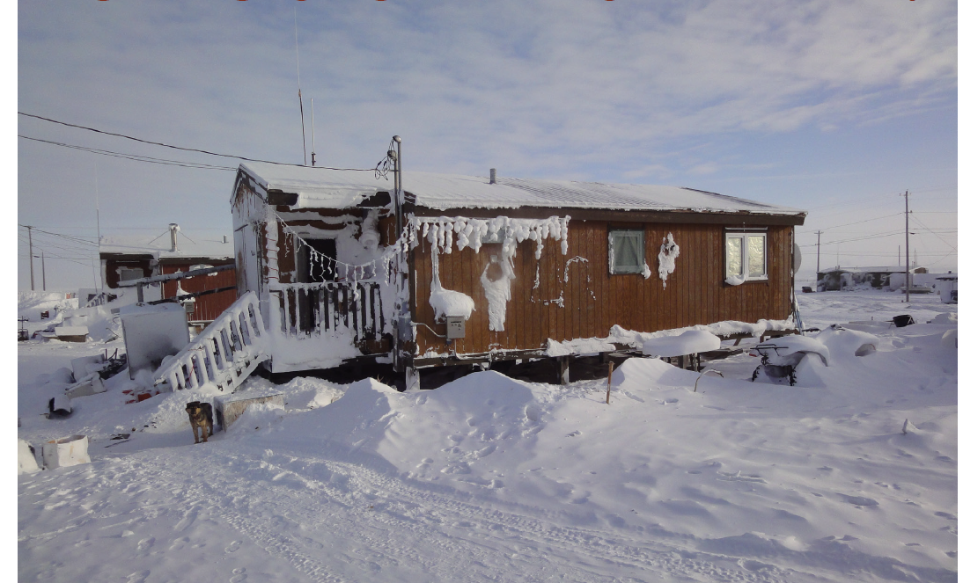
Lessons Learned:
Low Hanging Fruit:
Insulation
Tight Building Envelope
Mechanical Ventilation
Holistic Approach to Creating Solutions

Slide 10
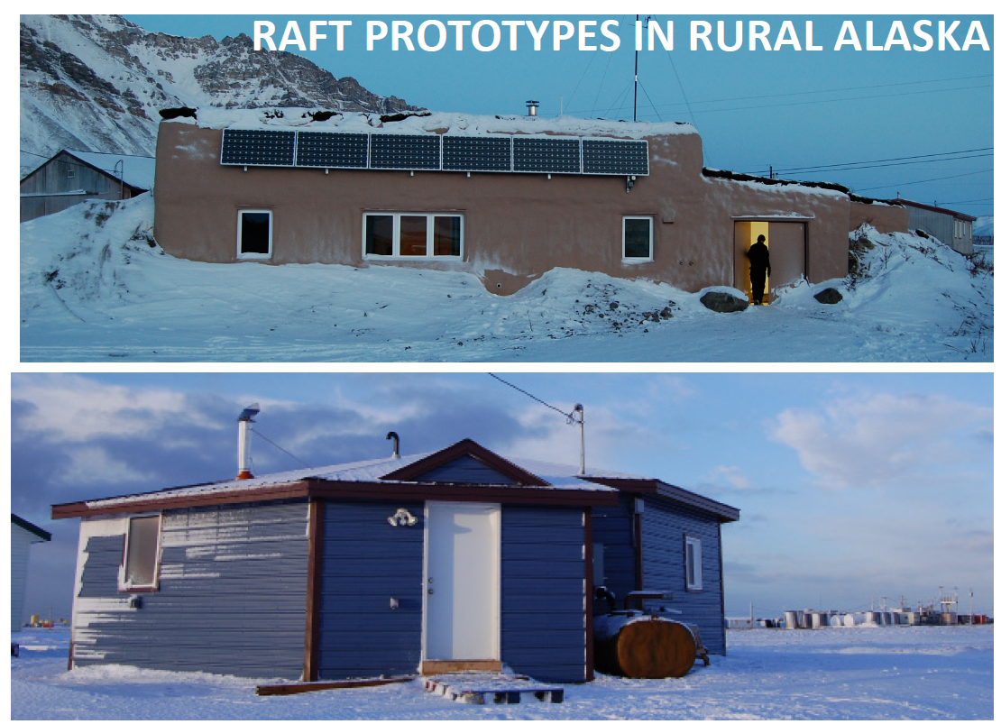

Slide 11
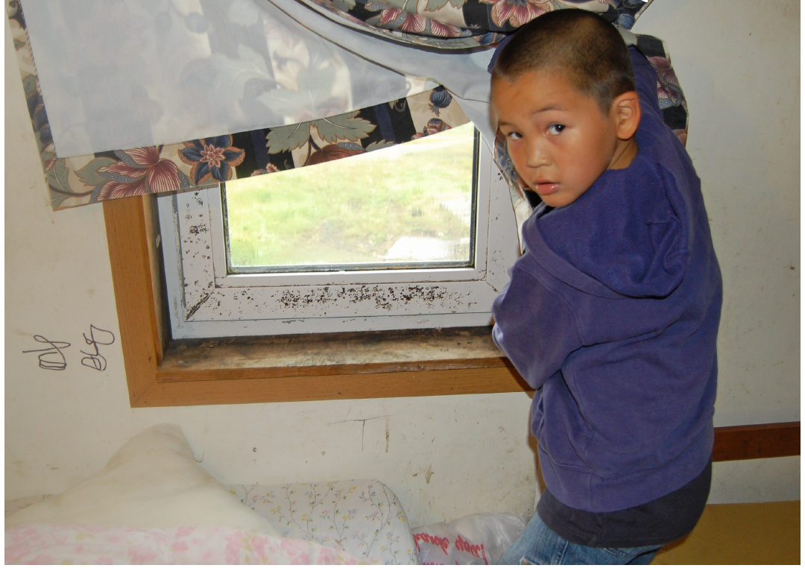

Slide 13
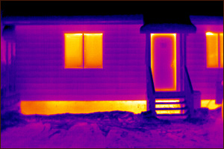
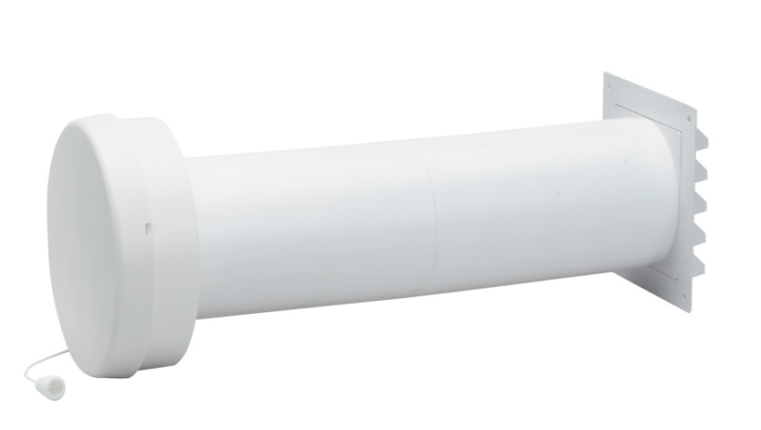
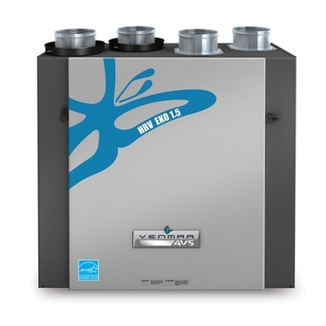
Cold Climate Housing Research Center
CCHRC
Heating and Ventilation
“No point in innovating if you think you already know the answer.”
-Daryl Kooley
Qingkok
Panasonic blower (preconditioned), Toyo
AKWarm Model (House in Fairbanks):
100 cfm continuous fresh air: 98 MMBtu/yr
HRV with 100 CFM intermittent: 67.7 MMBtu/yr
Savings: Equivalent of 233 gallons of fuel/yr
www.cchrc.org

Slide 14
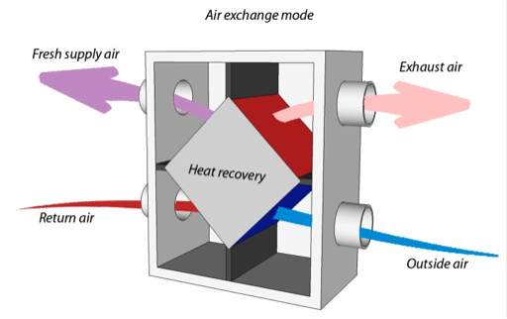
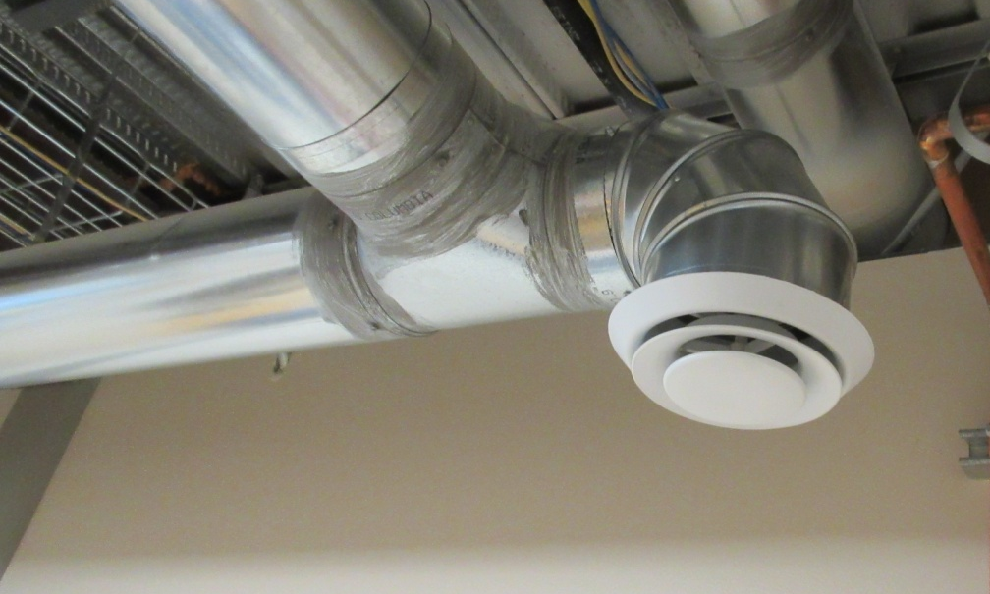

Slide 15
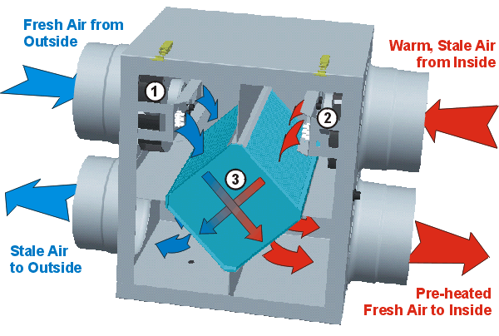
Cold Climate Housing Research Center
CCHRC
Heat Recovery Ventilators
Complaints
Use Electricity
Freezing Issues
Blows Cold Air
Maintenance
Noisy
New products
Efficiency - 65-75%, 90%
Freezing issues
Easier maintenance
Education
Sod
Earth berming
Waste water treatment
Heating and ventilation
Alternative energy
Lighting
www.cchrc.org

Slide 16
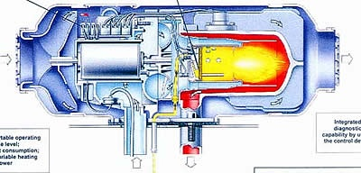
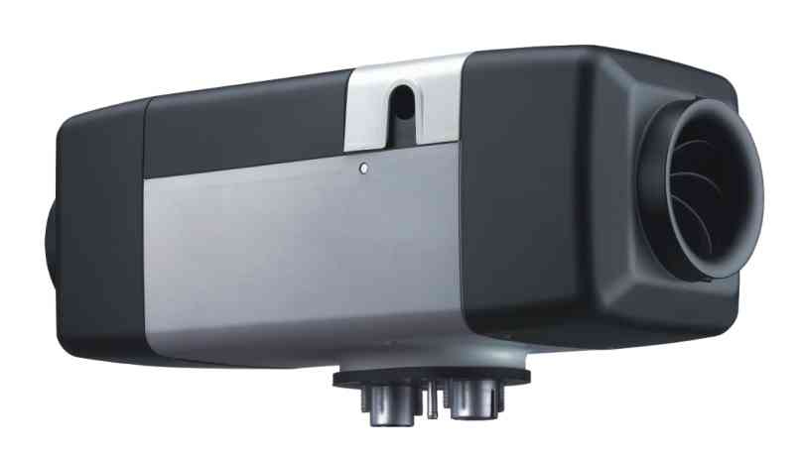
Cold Climate Housing Research Center
CCHRC
Anaktuvuk Pass
17,000 HDD
Prototype House
9,000 BTU/hr average heating load in January
12,000 BTU/hr design heating load @ -55°F
Webasto Cabin Heater
Output: 17,500 BTU/hr
Notes:
Our PTL researchers looked at the economic viability of GSHP in 5 cities in Alaska—Anchorage, Fairbanks, Juneau, Seward and Bethel. They are cost-competitive in places with expensive energy and affordable electricity. They pay off within 15 years in Fairbanks, Juneau and Seward.

Slide 17

Cold Climate Housing Research Center
CCHRC
Sod
Earth berming
Waste water treatment
Heating and ventilation
Alternative energy
Integrated Heating and Ventilation
Lighting
www.cchrc.org

Slide 18
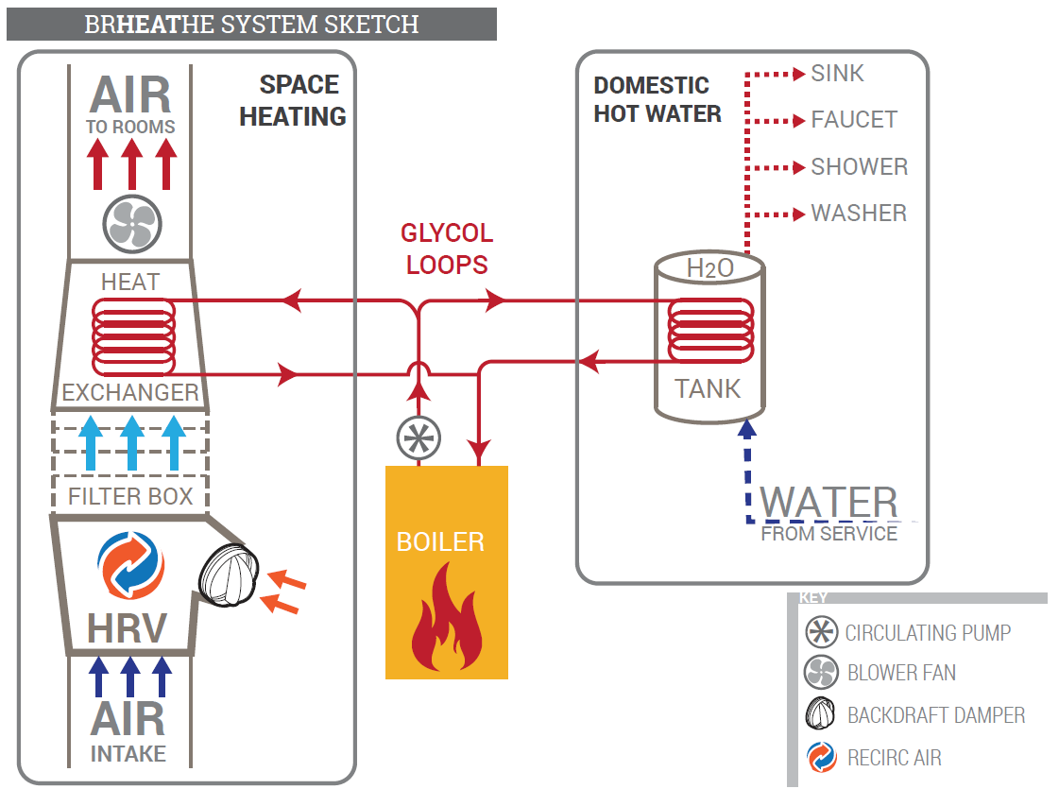

Slide 19


Slide 20
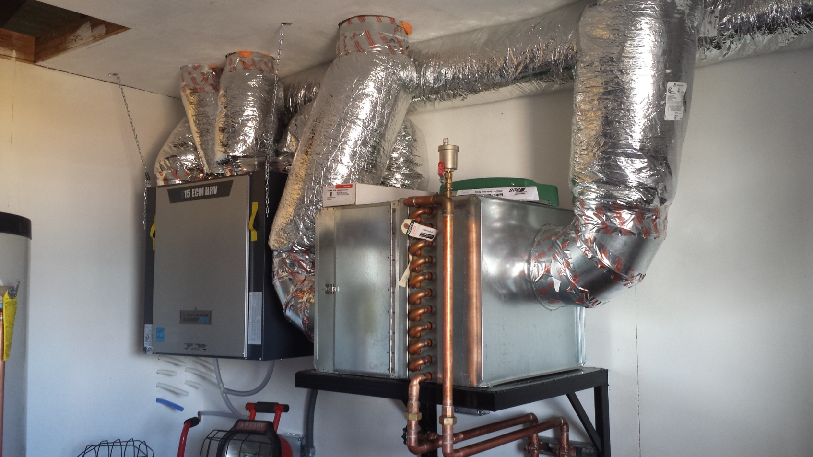

Slide 21
BrHEAThe System
What makes it unique?
  Balanced Airflow
  Recirculated Air
  Comfortable Fresh Air
  Primary Heating System
  Simple
  Energy Efficient
  Smart Thermostat

Slide 22
Lessons Learned:
Occupant behavior drives everything.
If integrating systems, get product support/buy-in.
Keep it simple.

Slide 23
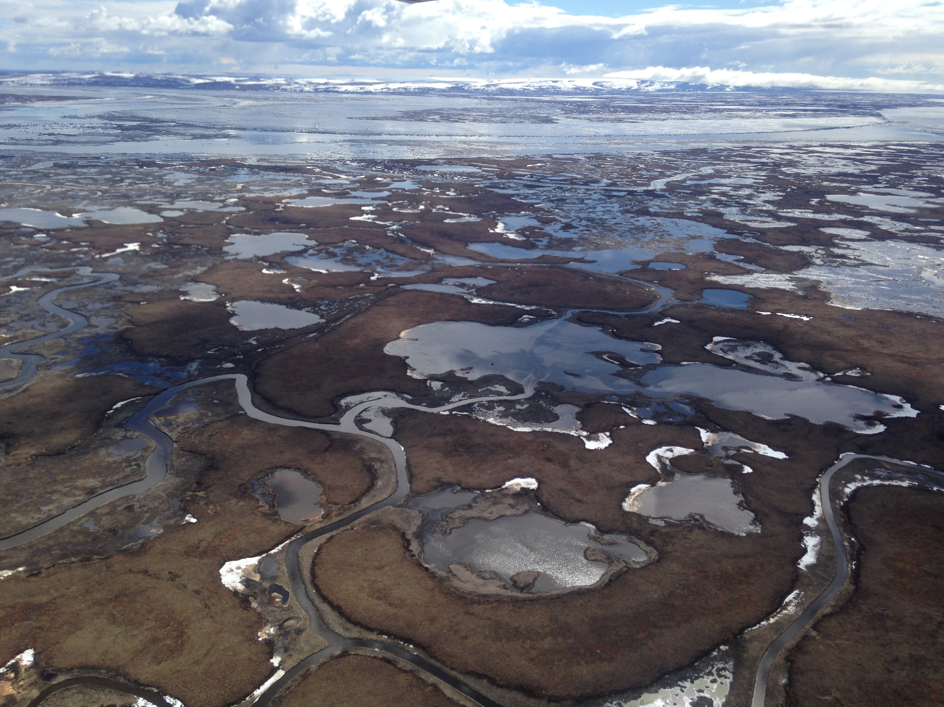
Future Challenge:
Addressing Climate Change

Slide 24
Cold Climate Housing Research Center
CCHRC
NEWTOK-MERKTARVIK
www.cchrc.org

Slide 25
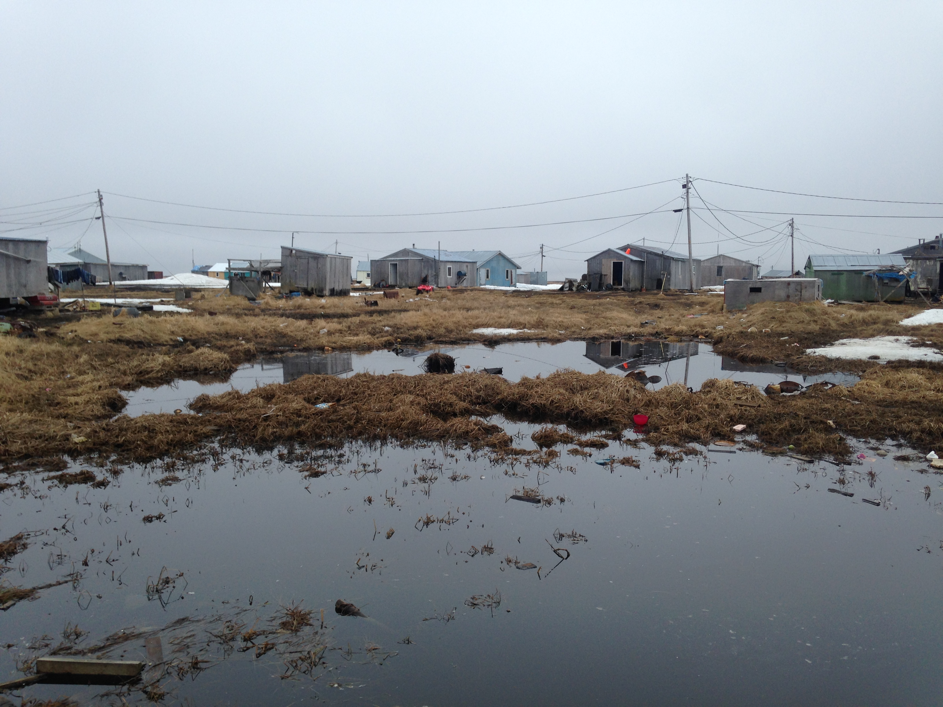
Cold Climate Housing Research Center
CCHRC
NEWTOK-MERKTARVIK
www.cchrc.org

Slide 26
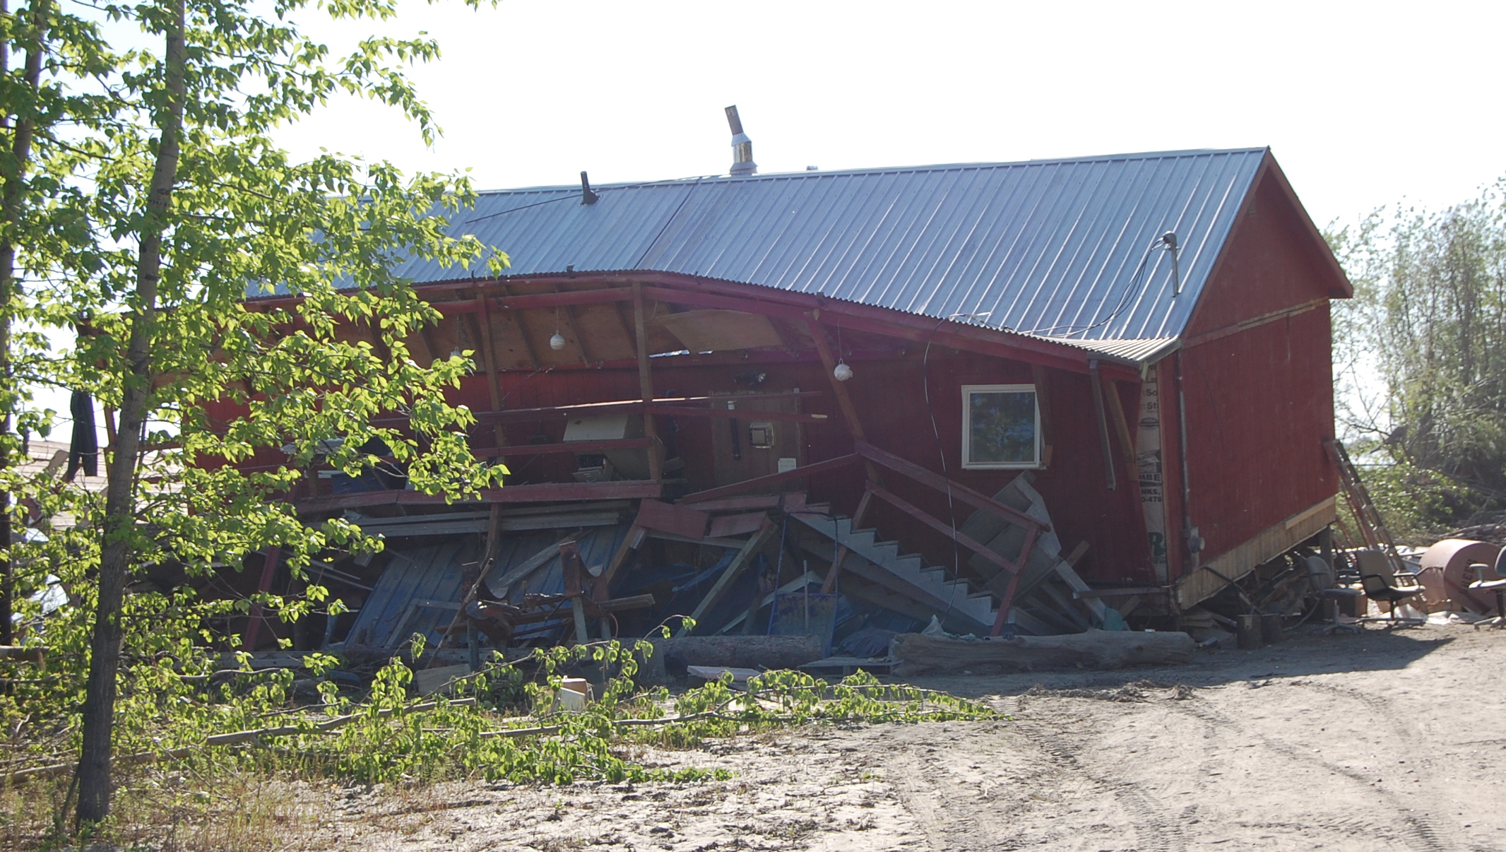
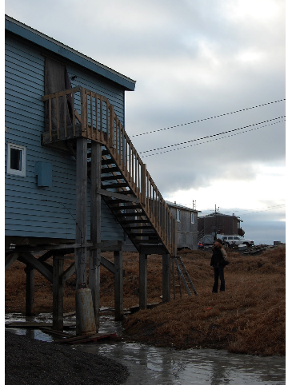
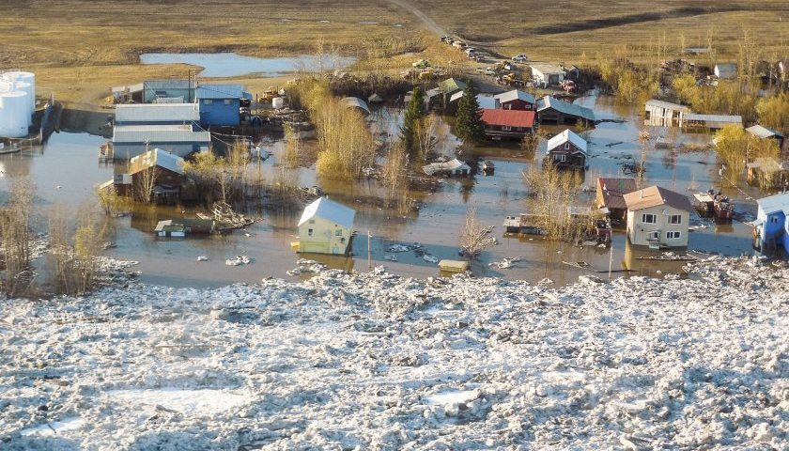
Cold Climate Housing Research Center
CCHRC
www.cchrc.org

Slide 27
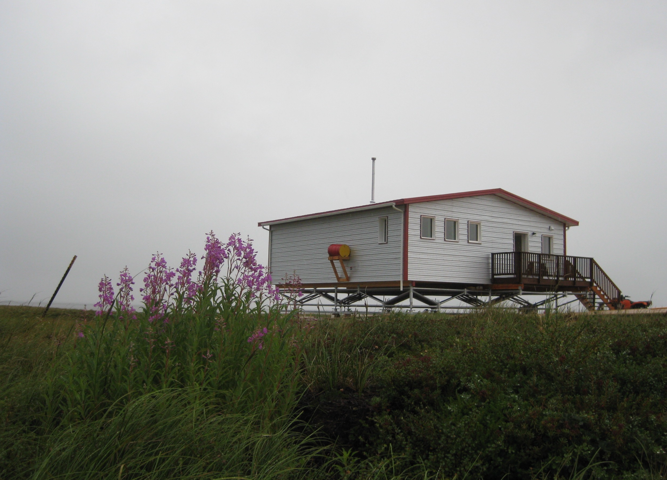
Cold Climate Housing Research Center
CCHRC
Newtok/ Merktarvik
www.cchrc.org

Slide 28
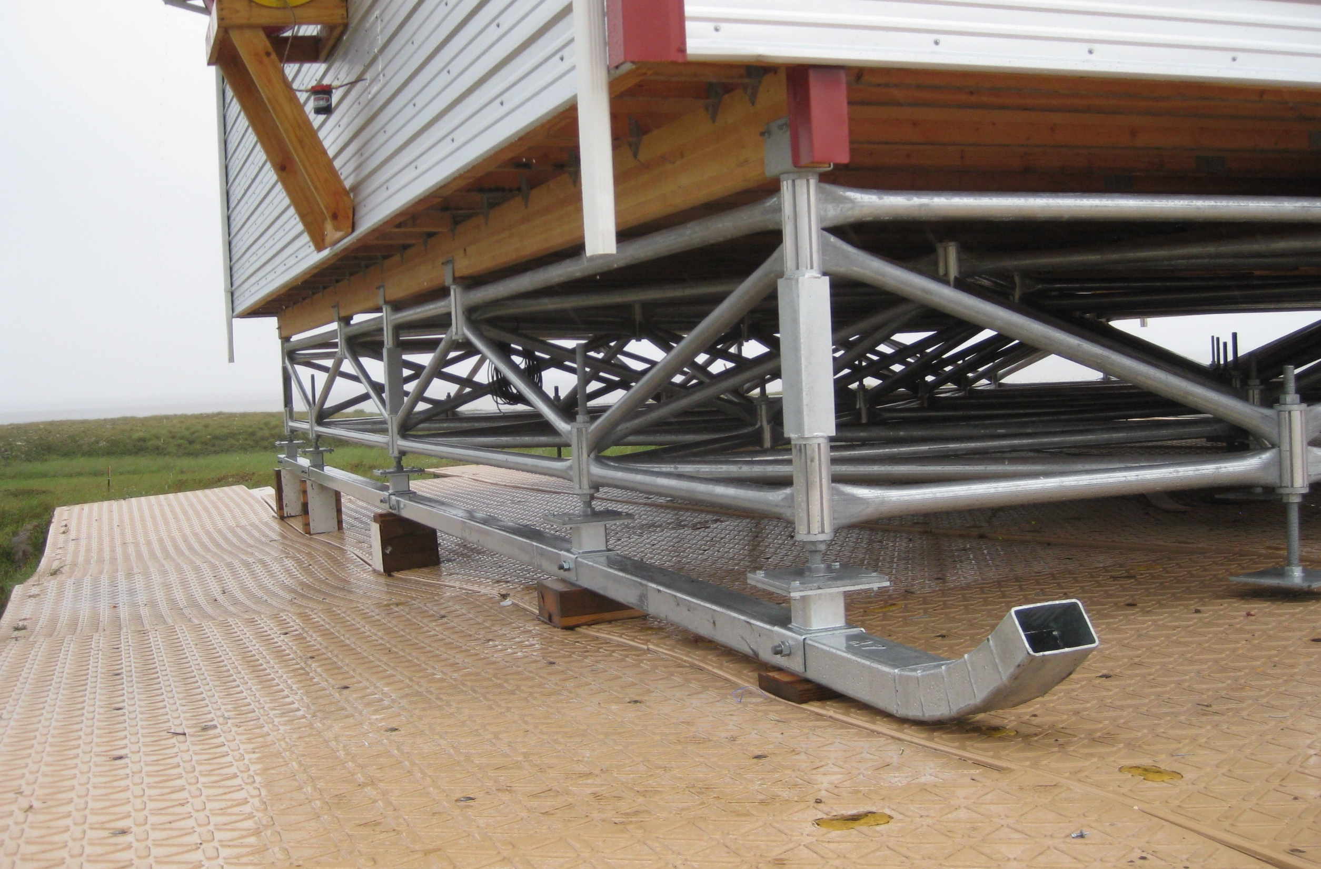
Cold Climate Housing Research Center
CCHRC
NEWTOK-MERKTARVIK
Anaktuvuk Pass Prototype
Quinhagak Prototype
www.cchrc.org
Notes:
Introducing renewable energy, alternatives to water and sewer, options in heating, engaging community, IAQ

Slide 29
Future Challenges:
How are we setting the example?
        - Adaptability to thawing permafrost
        - Erosion
        - Advancing Renewable Systems –
        weaning off oil
        - Healthy Homes
        - Next 13,000 years?

Slide 30
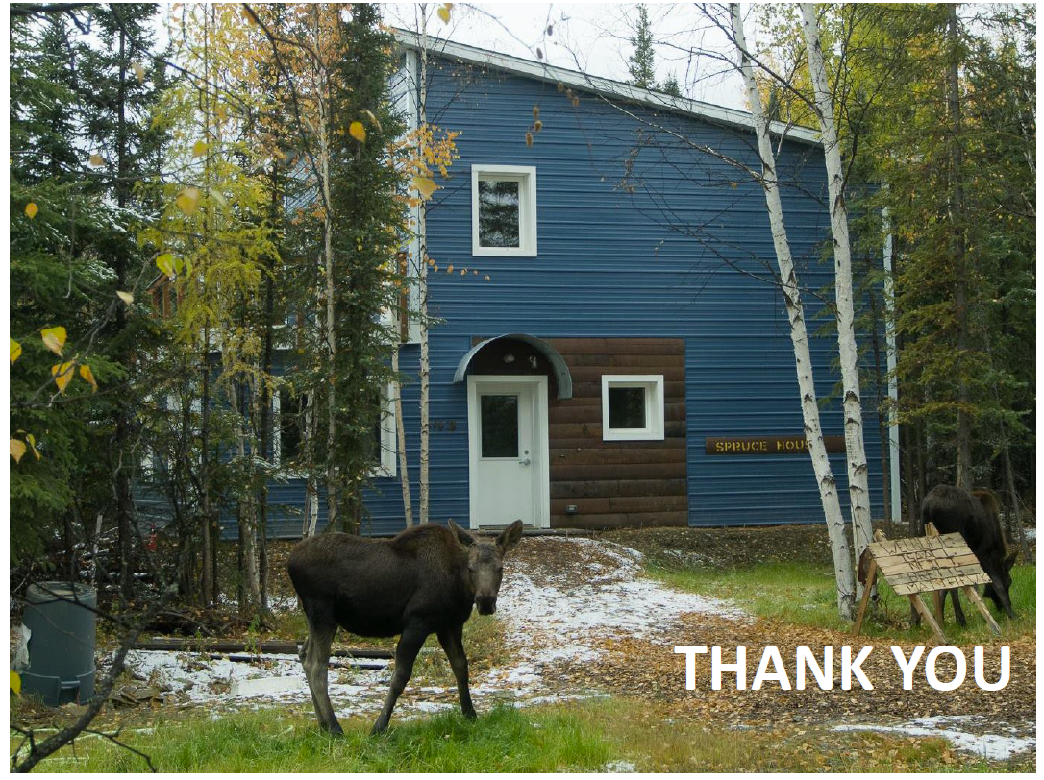

Slide 31
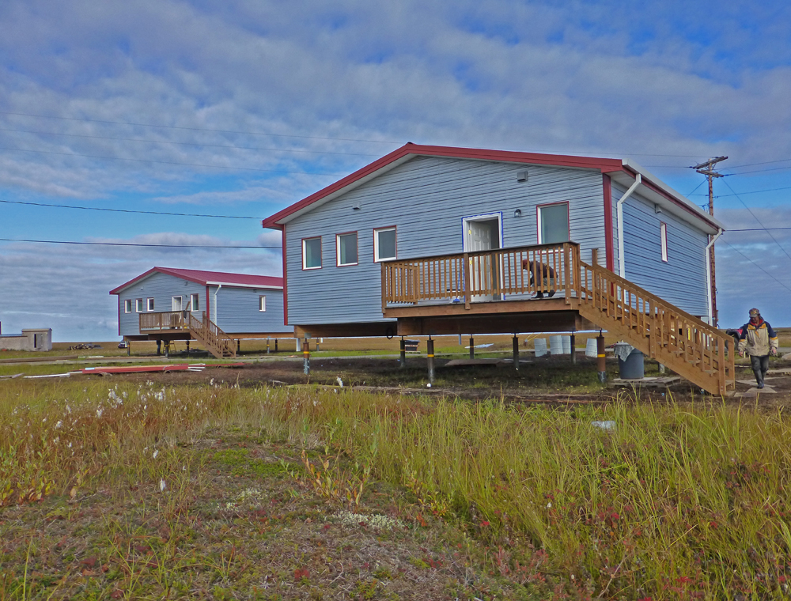
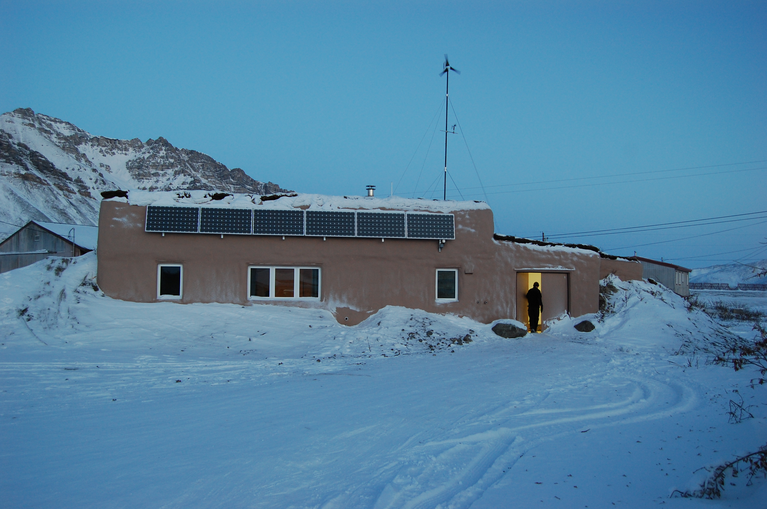
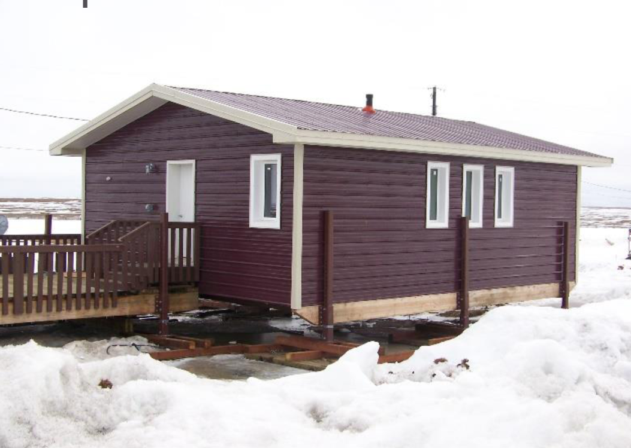
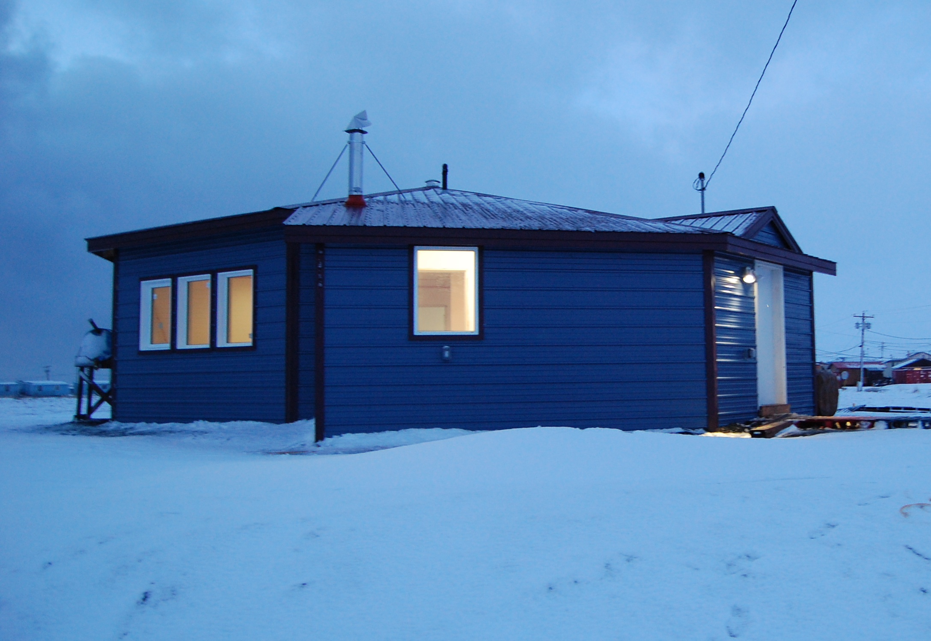
Cold Climate Housing Research Center
Sustainable Northern Communities
INNOVATIVE COLABORATIVE HOUSING DESIGN
CCHRC
Anaktuvuk Pass Prototype
Atmautluak Prototype
Average house: 1400 gal/yr
Prototype house: 160 gal/yr
Average house: 1200 gal/yr
Prototype house: 120 gal/yr
Quinhagak Prototype
North Slope
Average house: 1000 gal/yr
Prototype house: 150 gal /yr
Average house: 900 gal/yr
Prototype house: 132 gal/yr
www.cchrc.org
Notes:
Introducing renewable energy, alternatives to water and sewer, options in heating, engaging community, IAQ

